Slide 1
TECH REVOLUTION IN AFRICA

Slide 2
“computers are useless, they can only give you answers.” PABLO PICASSO.

Slide 3

Najla Almissalati.

Slide 4

Gabby Lobban.

Slide 5
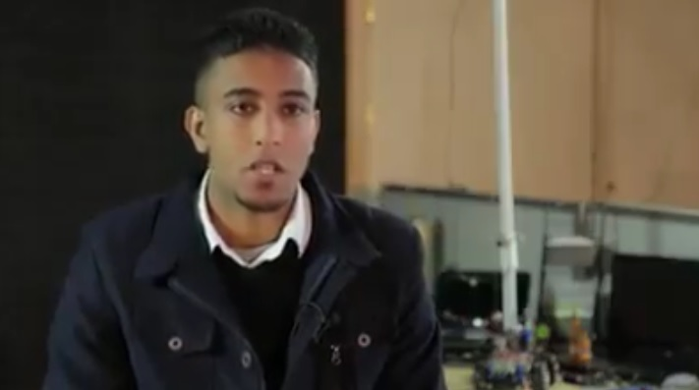
Kasim Al Arbi.
Inventor and developer of bombs diffuser robots.

Slide 6
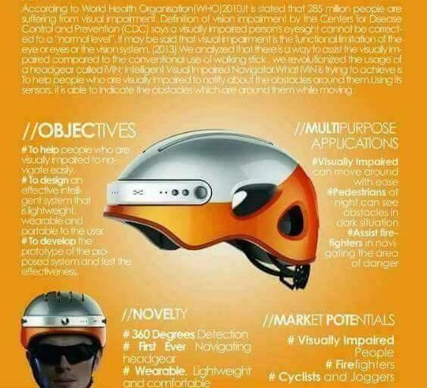
Saifullah Abu Jinnah.
Innovator and inventor of the (IVIN) intelligent visual impaired navigator.
Social entreprenuer

Slide 7
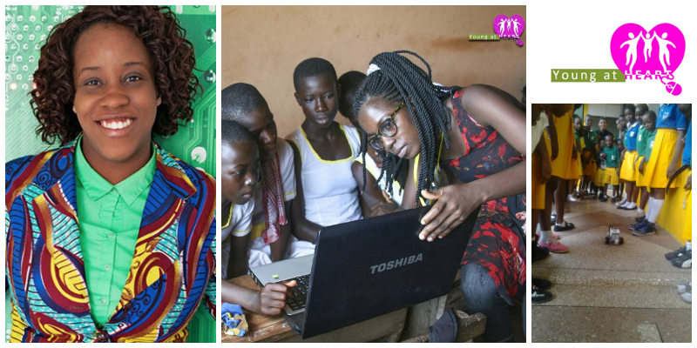
Josephine Marie.
Social entrepreneur.
Bringing world learning through digital platforms.

Slide 8
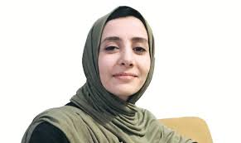
Fatima Nassar.
Social entrepreneur.
founder of yummy foods app

Slide 9
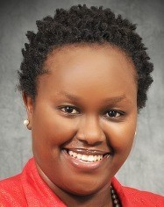
DORCAS MUTHONI.
CEO and founder of Open World Ltd.
It is a software consulting company

Slide 10
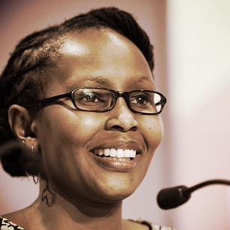
JULIANA ROTICH
co founder of ushahidi $ BRCK Inc
Social Entrepreneur

Slide 11

Kyai mullei $ David Mark
Founders of M-changa
A mobile application used to help fundraise for people in need.

Slide 12
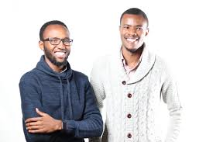
Tesh Mbaabu $ Mesongo Sibuti
Founders of Cloud9x mobile App.
A platform that gathers the best activities and travel destinations and trips across Africa in one place

Slide 13
Thank you by Stella Njeri.

